Slide 1
Santander Bank Product Recommendation: Data Analysis and Model Results
By Rucha Joshi

Slide 2
Santander Bank Product Recommendation Algorithm
Dataset : ~1 million customers (“users”), 24 products (“items”), and target variables like customer age, gender, income and geographic information.
Objective: Train a model to come up with product recommendation
Contrary to popular recommendation problems, like movie or amazon datasets, “rating” information is unavailable for this problem.

Slide 3
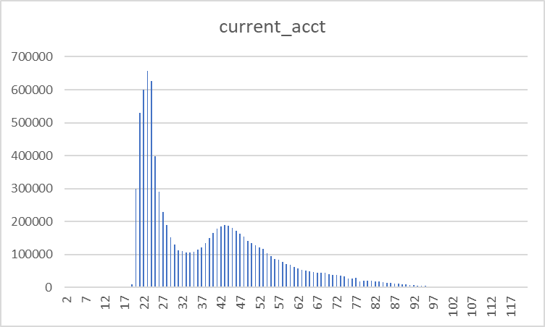
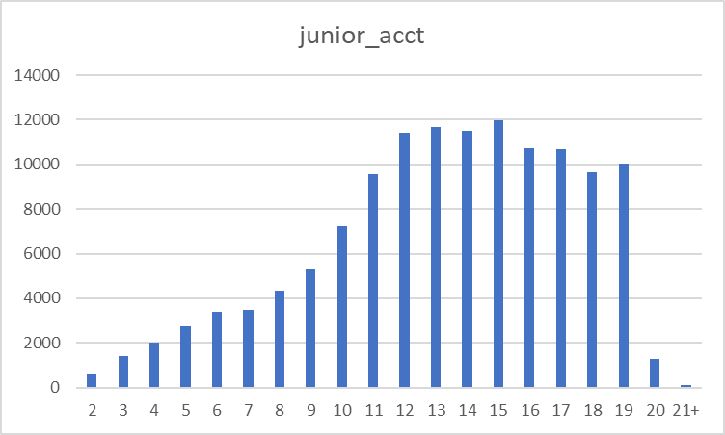
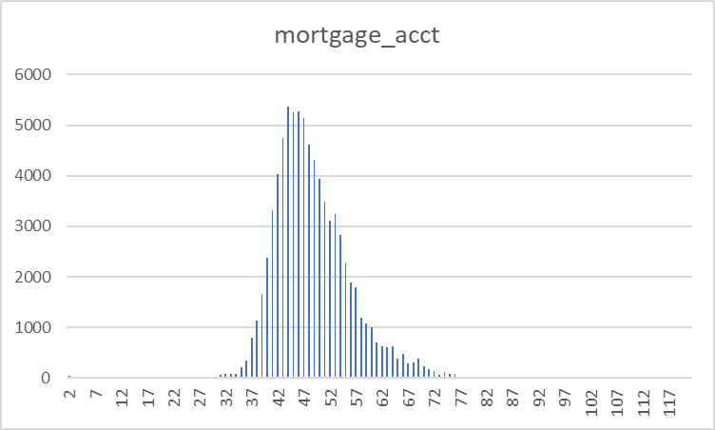
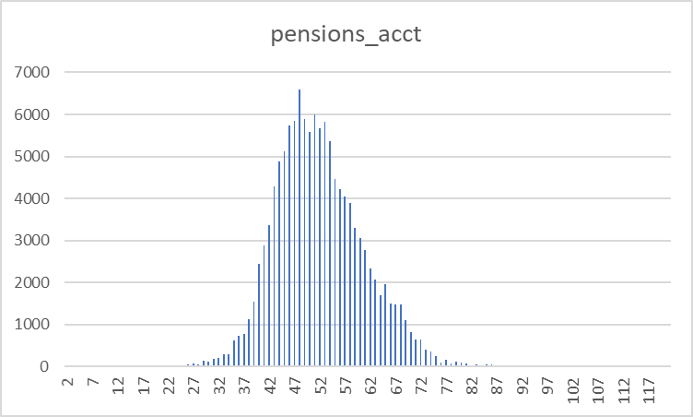
Data analysis: Customer age should be an important consideration for product recommendation

Slide 4
Customer age should be an important consideration for product recommendation
Account Type | Avg Customer age
current account | 38
junior account | 13
mortgage account | 49
pension account | 52

Slide 5
Thank You

